Slide 1
Diabetes Prediction App
(using Machine Learning)

Slide 2
Team Members
Mani Shankar Choudhary (manishankar.btech.cs19@iiitranchi.ac.in)
Kumar Shashank
(shashank.btech.ec19@iiitranchi.ac.in)
Savita Nandan
(royalkingsava@gmail.com)
Suraj Kumar
(surajpremium3788@gmail.com)

Slide 3
Diabetes Mellitus
Chronic disease that can cause worldwide health care crisis
Caused due to increased levels of glucose in blood levels
Diagnosed by various physical and chemical test
Affects vital human organs such as heart, nerves, kidney etc
Prediction of diabetes at early stage is still a challenging task
382 million people are diabetic in the world as per reports of International Diabetes Federation

Slide 4
Machine Learning
Scientific way dealing with the ways in which machines learn from experience
ML is sometimes referred identical to Artificial Intelligence
Purpose of ML is to develop computer systems that can adapt and learn from their experience
Enables software application to become more accurate at predicting outcomes without explicitly programmed to do so

Slide 5
Project
The whole project is completed in three steps:
1. Creating a model using machine learning
2. Developing a web application using flask
3. Connecting the webapp to the model

Slide 6
Flask
Web Framework
Python module that helps developing web applications easily
Small and easy-to-extend core
Microframework that doesn’t include ORM(Object Relational Manager) or such features

Slide 7
Model Implementation
Install Anaconda that comes along with Jupyter Notebook and all other essential python packages like numpy, pandas, matplotlib, seaborn etc.
Open jupyter notebook
Import the necessary libraries
Load the dataset
Perform EDA on dataset
Modelling and training of data
Improving accuracy of model
Evaluate the model and save it

Slide 8
Web App
Create a web app using flask
Create HTML files(detect.html and result.html) for taking input and rendering output on screen
Connect the app to the model

Slide 9
Execution
Open Anaconda Command Prompt
Go to Project location in your system
Run the command :
python app.py

Slide 10
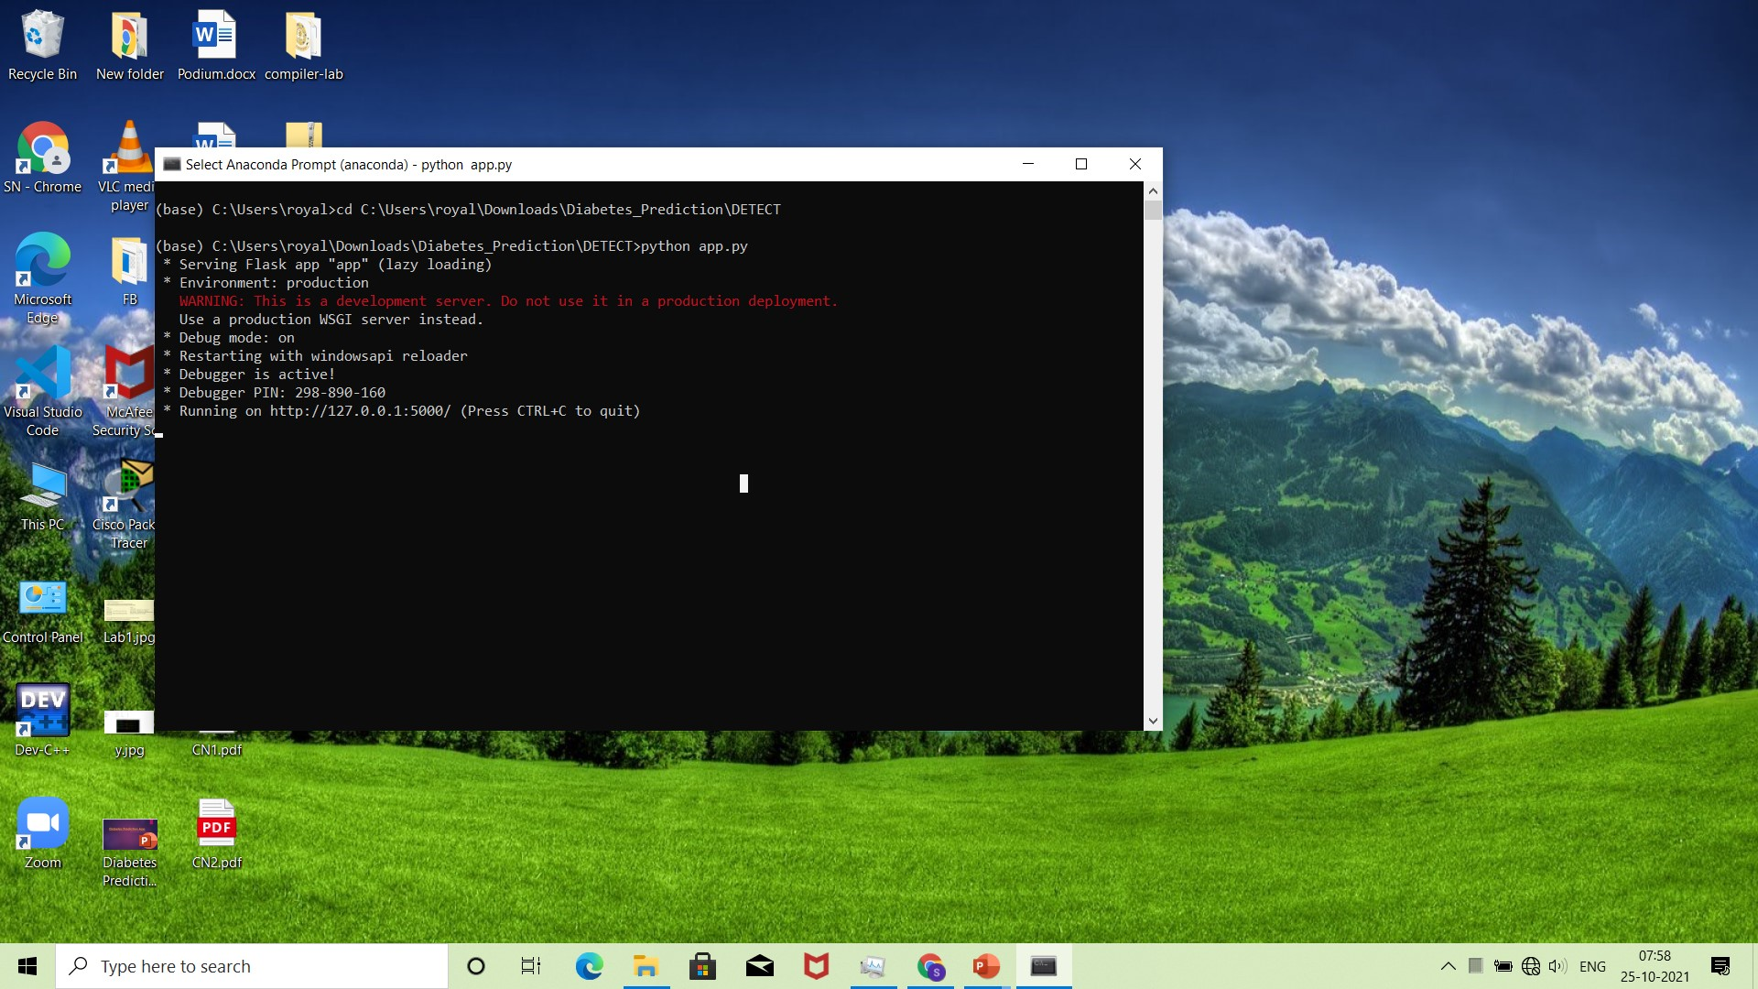
Screenshots

Slide 11
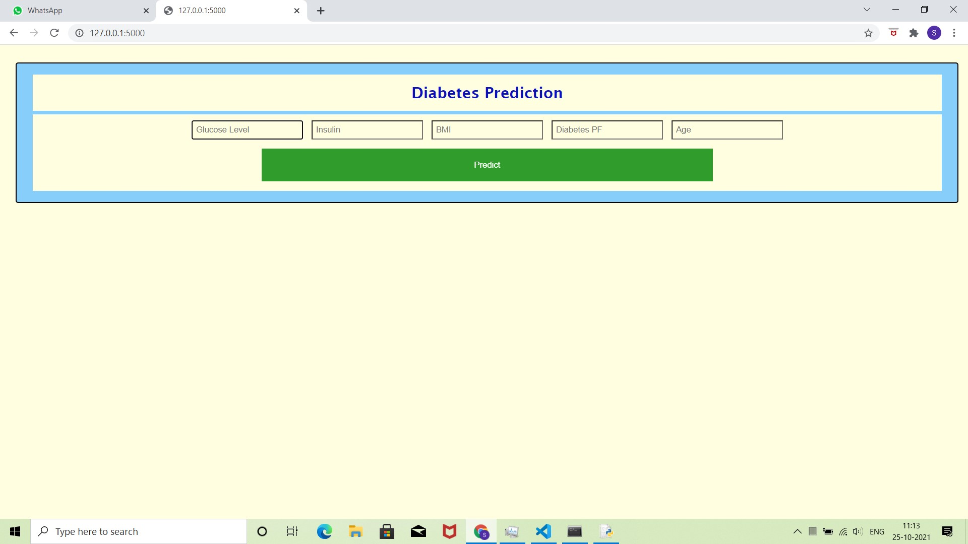

Slide 12
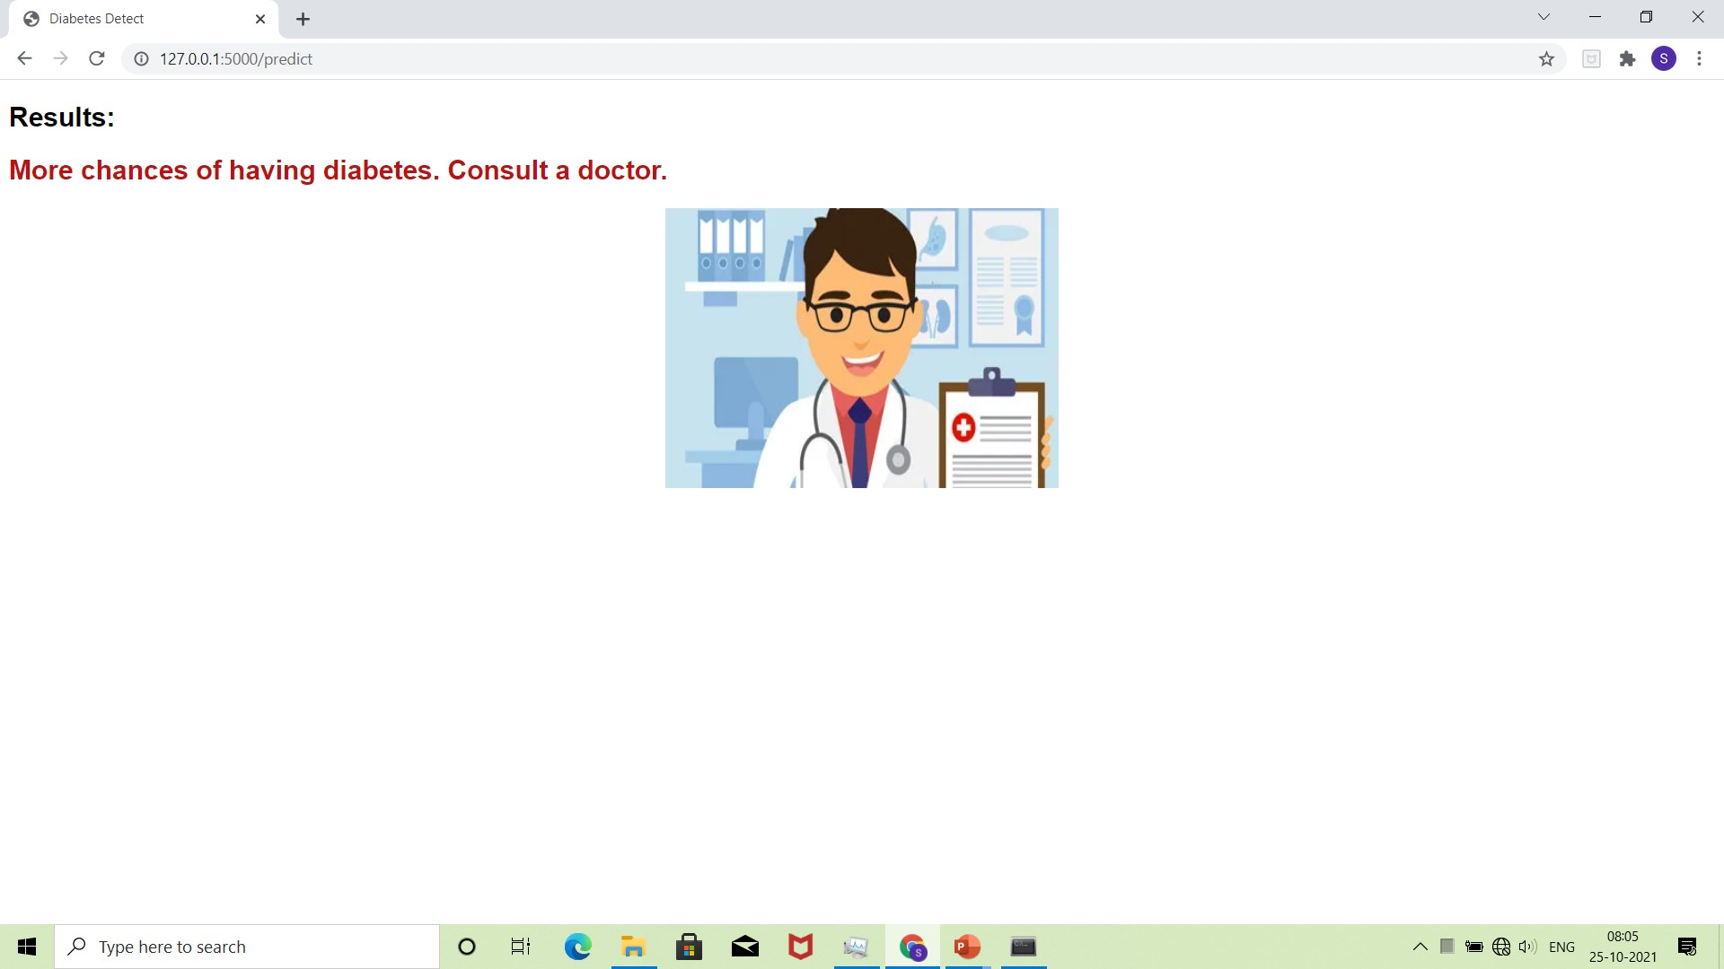

Slide 13
Conclusion
With the help of advance computational algorithm and availability of large amount of genetic and epidemiological diabetes risk dataset, the prediction has been becoming accurate
Detection of Diabetes in early stage is the key for treatment
The project work has used a model to detect diabetes

Slide 14
Thank You

